Slide 1
WALKER FOR BLIND PEOPLE USING DEEP LEARNING

Slide 2
TEAM
Mentor: Gaurav Sharma
Ajinkya Bedekar (U101116FCS183)
Archana Gujar (U101116FEC158)
Chinju Mary George (U101116FCS025)
Dhruva Agarwal (U101116FCS177)
Soumyadip Ghosh (U101116FCS133)
Notes:
Add mentor name

Slide 3
RATIONALE OF WORK
About 39 million people are blind worldwide, out of which 12 millions are Indian (almost 32.5%).
Government policies (NPCB) are not sufficient to overcome the problem of providing self sustaining capabilities to them.
A technology oriented approach can help to solve this problem.
Smart walker can help blind people to be more independent without any human intervention.

Slide 4
OBJECTIVE
Many blind people require travel aids to navigate in unknown environment. In this project, we are trying to develop a walker for the blind people that does not only provide walking assistance but also enables blind user with mobility impairment to avoid obstacles and reach their destination without human assistance.

Slide 5
LITERATURE REVIEW
Divided into 2 parts:
Existing Walkers for Blind People
Self Driving Car Concept

Slide 6
LITERATURE REVIEW(Existing Walker Technology)
1 | Smart Walker by Gaby Abou Haidar, Roger, Achkar, Richard Maalouf Publication: International Journal of Computing and Digital Systems | Hardware based solution with microcontrollers, camera, IR sensor, pulse sensor, speakers, IOT
2 | Multisensor guided walker for visually impaired elderly people Conference Paper · September 2015 | Ultrasonic sensors input, orientation and guiding algorithm embedded in microcontroller, motors, etc

Slide 7
3 | A Navigation Aid for Blind People with Walking Disabilities Andreas Wachaja, Pratik Agarwal, Miguel Reyes Adame, Knut Moller, Wolfram Burgard | Vibration belt, lazer inputs, servo motor, HLD classifier
4 | A Wearable Mobility Aid for the Visually Impaired based on embedded 3D Vision and Deep Learning[7] Matteo Poggi, Stefano Mattoccia | 3D sensing, ETS system, Stereo vision, FPGA, odroid U3, CNN

Slide 8
LITERATURE REVIEW(Self driving car concept)
A model has been proposed for Self-Driving car in which it takes the image through Raspberry Pi [1].
Raspberry Pi sends the image captured as an input image to Convolutional Neural Network. The image is gray-scaled before passing it to the Neural Network.
Upon prediction the model gives one of the four output i.e. left, right, forward or stop. When the result is predicted corresponding Arduino signal is triggered which in turn helps the car to move in a particular direction with the help of its controller.

Slide 9
LITERATURE REVIEW CONTD...
Camera module takes the image
Direction Prediction Algorithm
Steps for the self driving model
Arduino sends
the signal to the
car via Remote
controller
Control Signal to Arduino Microcontroller

Slide 10
Convolutional Neural Networks
Input Image
Feature Detector
Convolution
Max Pooling
Flattening
Full Connection
4 Main steps involved in CNN
Object Detected
Notes:
convolution-->feature map-->relu-->maxpooling-->1d matrix conversion-->sending it to ann as input layer
Rectifie linearity unit

Slide 11
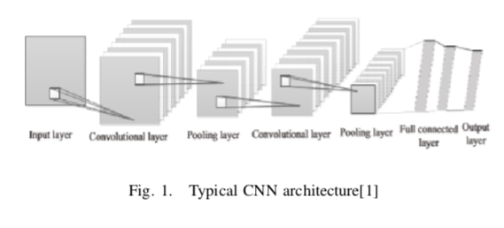

Slide 12
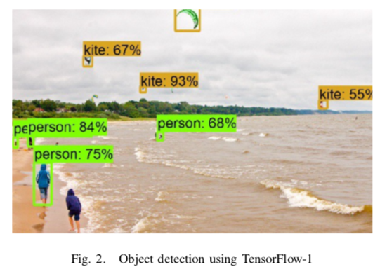

Slide 13
An implementation of lane detection algorithm for Self-Driving Car has been explained [2].
The author has used Computer Vision, Sensor Fusion, Deep Learning, Path Planning, Actuator System for the implementation
Image Processing methods are used which are a combination of colour region, line selection, canny edge detection, and Hough transform.
As suggested by the author, some method needs to be added to the algorithm that can change the parameters during day and night adaptively because constant parameters can only be used in same lighting conditions.

Slide 14
LITERATURE REVIEW CONTD...
Image Capture
Color Selection
Region Masking
Canny Edge
Hough Transform
Lane Identified
Steps for Lane Detection

Slide 15
LITERATURE REVIEW CONTD...
A model of self driving car using CNN and Road Lane Detector has been proposed.
YOLO (You Only Look Once) is used as the object detector [3]
Polynomial regression is used as the road guidance.
Edge detection Approach for lane detection : Sobel, Laplacian, and Canny Detectors.
Edge detection and the lane detection to run in parallel for faster computation

Slide 16
LITERATURE REVIEW CONTD...
Steps involved in YOLO :
Resize image input
Feed resized images to convolutional layers
Outputs of Detection
Pre-trained Object Detection
Prediction of bounding boxes
Object Label
X, Y midpoint coordinate
Width and Height of object
Probability of Correctness
Notes:
Filtering : div(x,y) = (M31x+ M32y+ M13) ; dst(x,y) = (M11x+ M12y+ M13, M21x+ M22y+ M23)/div(x,y)
De-Warping : Polyfit(x,y,2) = p2 x + px + p ; E = sigma(Polyfit(x,y,2) – y)2

Slide 17
LITERATURE REVIEW CONTD...
Limitations mentioned by the author :
Accommodating undetected road lanes
Effects of sudden over lighting/illumination to recording camera/environment
Inaccurate detection of sharp-turned roads

Slide 18
TECHNOLOGIES BEING USED (TENTATIVE)
Deep Learning ( Convolutional Neural Networks, Artificial Neural Networks) for Feature Extraction and Object Detection
Google Maps API
Python for Programming
Object Detection API(YOLO, Tensorflow, etc.)

Slide 19
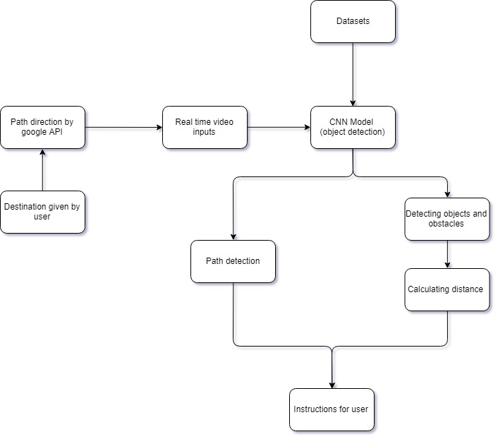
WORKFLOW

Slide 20
EXPECTED DELIVERABLES
Algorithms to achieve the desired output.
Software simulation/prototype of the actual product

Slide 21
FUTURE SCOPE
A walker with camera and wearable headphones for the blind ones. The camera captures real time video and will provide instruction to the user to reach his destination safely.

Slide 22
REFERENCES
Aditya Kumar Jain, ”Working model of Self-driving car using Convolutional Neural Network, Raspberry Pi and Arduino”, Dharmsinh Desai University, 2018
Mochamad Vicky Ghani Aziz, Ary Setijadi Prihatmanto, Hilwadi Hindersah, ”Implementation of lane detection algorithm for self-driving car on toll road cipularang using Python language”, School of Electrical Engineering and Informatics, ITB, 2017
Brilian Tafjira Nugraha1, Shun-Feng Su2, Fahmizal, ”Towards self-driving car using convolutional neural network and road lane detector”, Department of Electrical Engineering , 2017
https://googlecarjames.weebly.com/details.html

Slide 23
REFERENCES
5. IEEE Spectrum report: self driving car (link)
6. Self-driving and driver relaxing vehicle: Research Gate
7. Matteo Poggi,Stefano Mattoccia,A Wearable Mobility Aid for the Visually Impaired based on embedded 3D Vision and Deep Learning,Department of Computer Science and Engineering (DISI)
8. https://www.hindustantimes.com/india-news/india-to-change-definition-of-blindness-reduce-number-of-blind-by-4-million/story-HxHKeH3XpfPBEtSr2moerO.html
9. Pallav Doshi, Shubhankar Punktambekar, Niraj Kini, Simarjeet Singh Dhami,”Object Detection and its Application using Convolutional Neural Network”,Department of Computer Engineering, NBNSSOE

Slide 24
THANK YOU!!

